Slide 1
A Semantic eScience Platform for Chemistry
Using the oreChem experiments ontology: Planning and Enacting Chemistry
Mark Borkum, Carl Lagoze, Jeremy Frey and Simon Coles 22 Aug 2010 ACS RDF Symposium

Slide 2
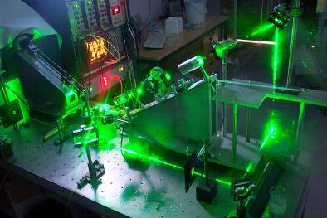
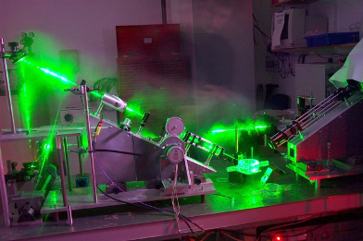
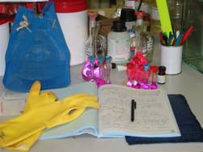
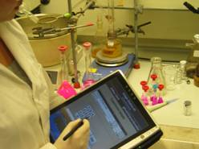
Overview
Introduction
Technology in Context
Data Model and Ontology
Applications
Summary

Slide 3
Introduction

Slide 4
The Data Deluge
“Lots of producers; generating more data than ever before.”
https://twitter.com/markborkum/status/20411273528
http://wallpapers.free-review.net/wallpapers/42/Big_wave.jpg

Slide 5
“Water, water, everywhere, Nor any drop to drink.” Samuel Taylor Coleridge – The Rime of the Ancient Mariner (1798)

Slide 6
Data-driven Science
Stimulated by advances in computing, sensor, and network technologies
Scientific fields differ in their “receptiveness” to these innovations
http://research.microsoft.com/en-us/collaboration/fourthparadigm/

Slide 7
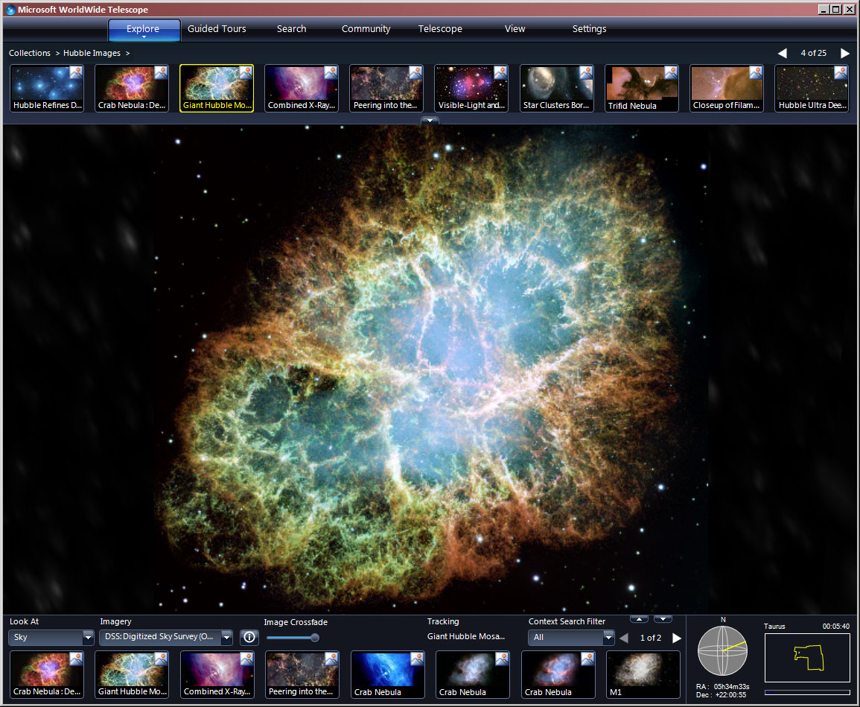
Notes:
The crab nebula

Slide 8
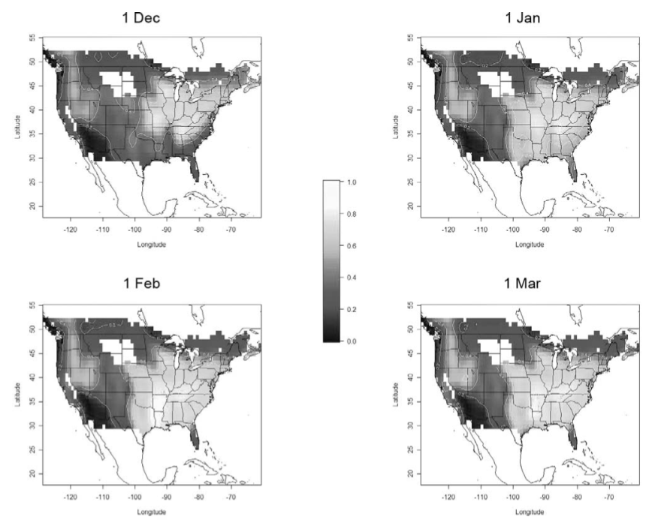
Notes:
W.M. Hochachka, R. Caruana, D. Fink, A.R.T. Munson, M. Riedewald, D. Sorokina, and S. Kelling. “Data-mining discovery of pattern and process in ecological systems”, Information, vol. 71, no. 7, 2004.

Slide 9
What about Chemistry?
Chemistry has been a relatively slow adopter…
Specifically, experimental chemistry
A contrast to Bioinformatics
There is a need for joined up thinking across the life sciences arena

Slide 10
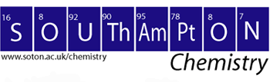
The oreChem Project
Funded by Microsoft External Research
Collaboration between chemists, cheminformaticians, information scientists, and computer scientists

Slide 11
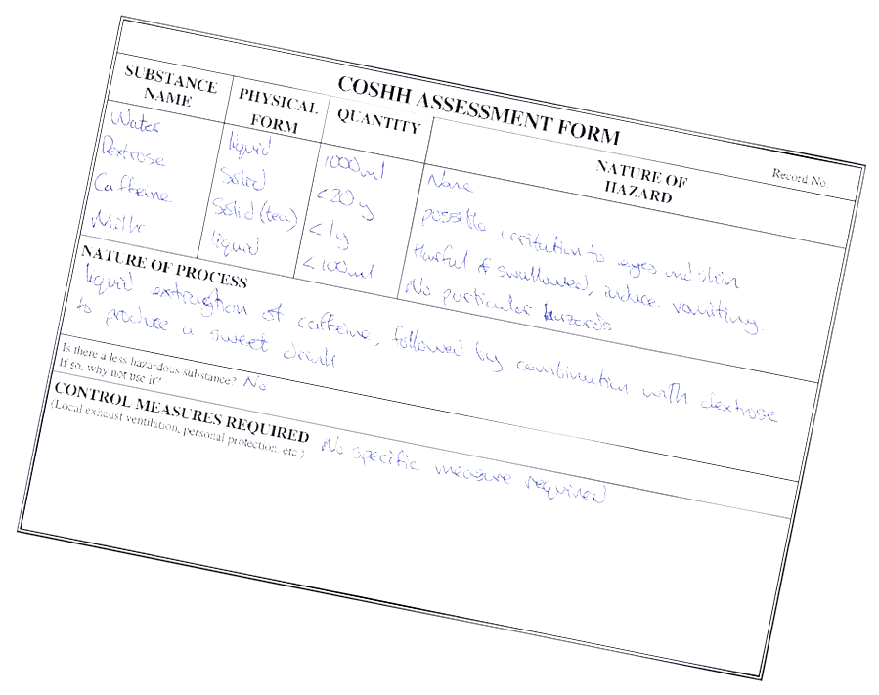
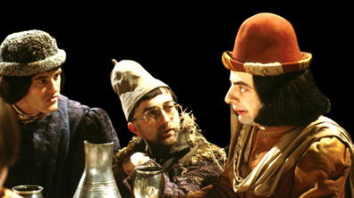
The oreChem Project – Goals
Provide an interoperability infrastructure for chemistry on the Semantic Web
Facilitate the capture, dissemination and reuse of derived and reported results in the correct context
COSHH Leverage off things we already have to do
“We have a cunning plan”

Slide 12
The PLAN is a key ingredient to efficient and safe working
The Southampton Semantic Laboratory Electronic Journal

Slide 13
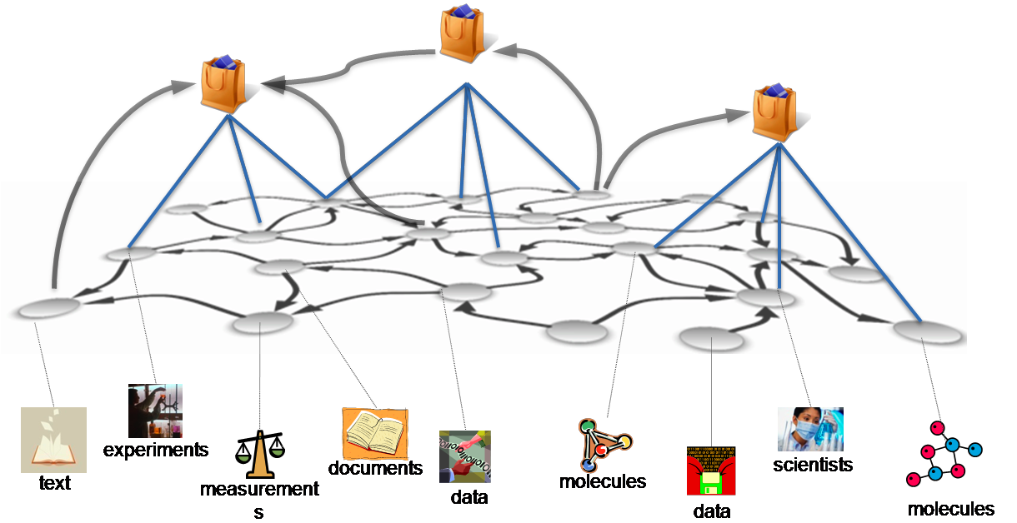
http://research.microsoft.com/en-us/projects/OREChem/picture1.png

Slide 14
“I keep six honest serving-men (They taught me all I knew); Their names are What and Why and When And How and Where and Who.” Rudyard Kipling – The Elephant’s Child (1902)

Slide 15
A Question of Data
Where does the data come from?
When was the data created (and modified)?
Who generated the data?
What does the data mean?
Provenance
Revision Control
Authorship
Description
TRUST

Slide 16
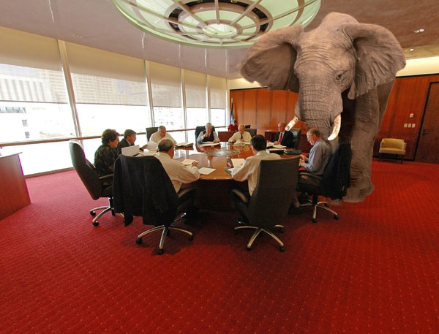
The Elephant in the Room
Why does the data exist?
http://riverdaughter.files.wordpress.com/2008/11/elephant-in-the-room.jpg

Slide 17
The Elephant in the Room (2)
Where – Retrospective Provenance
When – Revision Control
Who – Authorship
What – Description
Why – Prospective Provenance
TRUST

Slide 18
Prospective Provenance
The “recipe” for realising data products
Also referred to as methods, protocols and workflows
http://www.myexperiment.org/workflow/version/image/1226/pathways_and_gene_annotations_forqtl_region.png

Slide 19
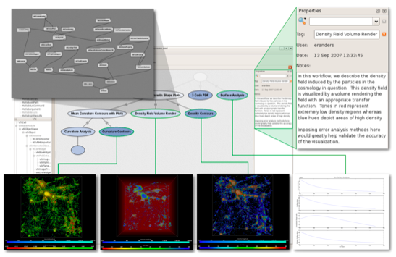
Retrospective Provenance
The “record” of the realisation of data products
Also referred to as the lineage, pedigree or audit tail
May additionally include context and annotations
http://www.vistrails.org/images/Cosmology_example.png

Slide 20
What is context?
Context is information that affects the interpretation of the data. For example:
Agents Who created (and modified) the data?
Timestamps When was the data created (and modified)?
Method Methods, Techniques, Background
Geo* Where was the data created (and modified)?

Slide 21
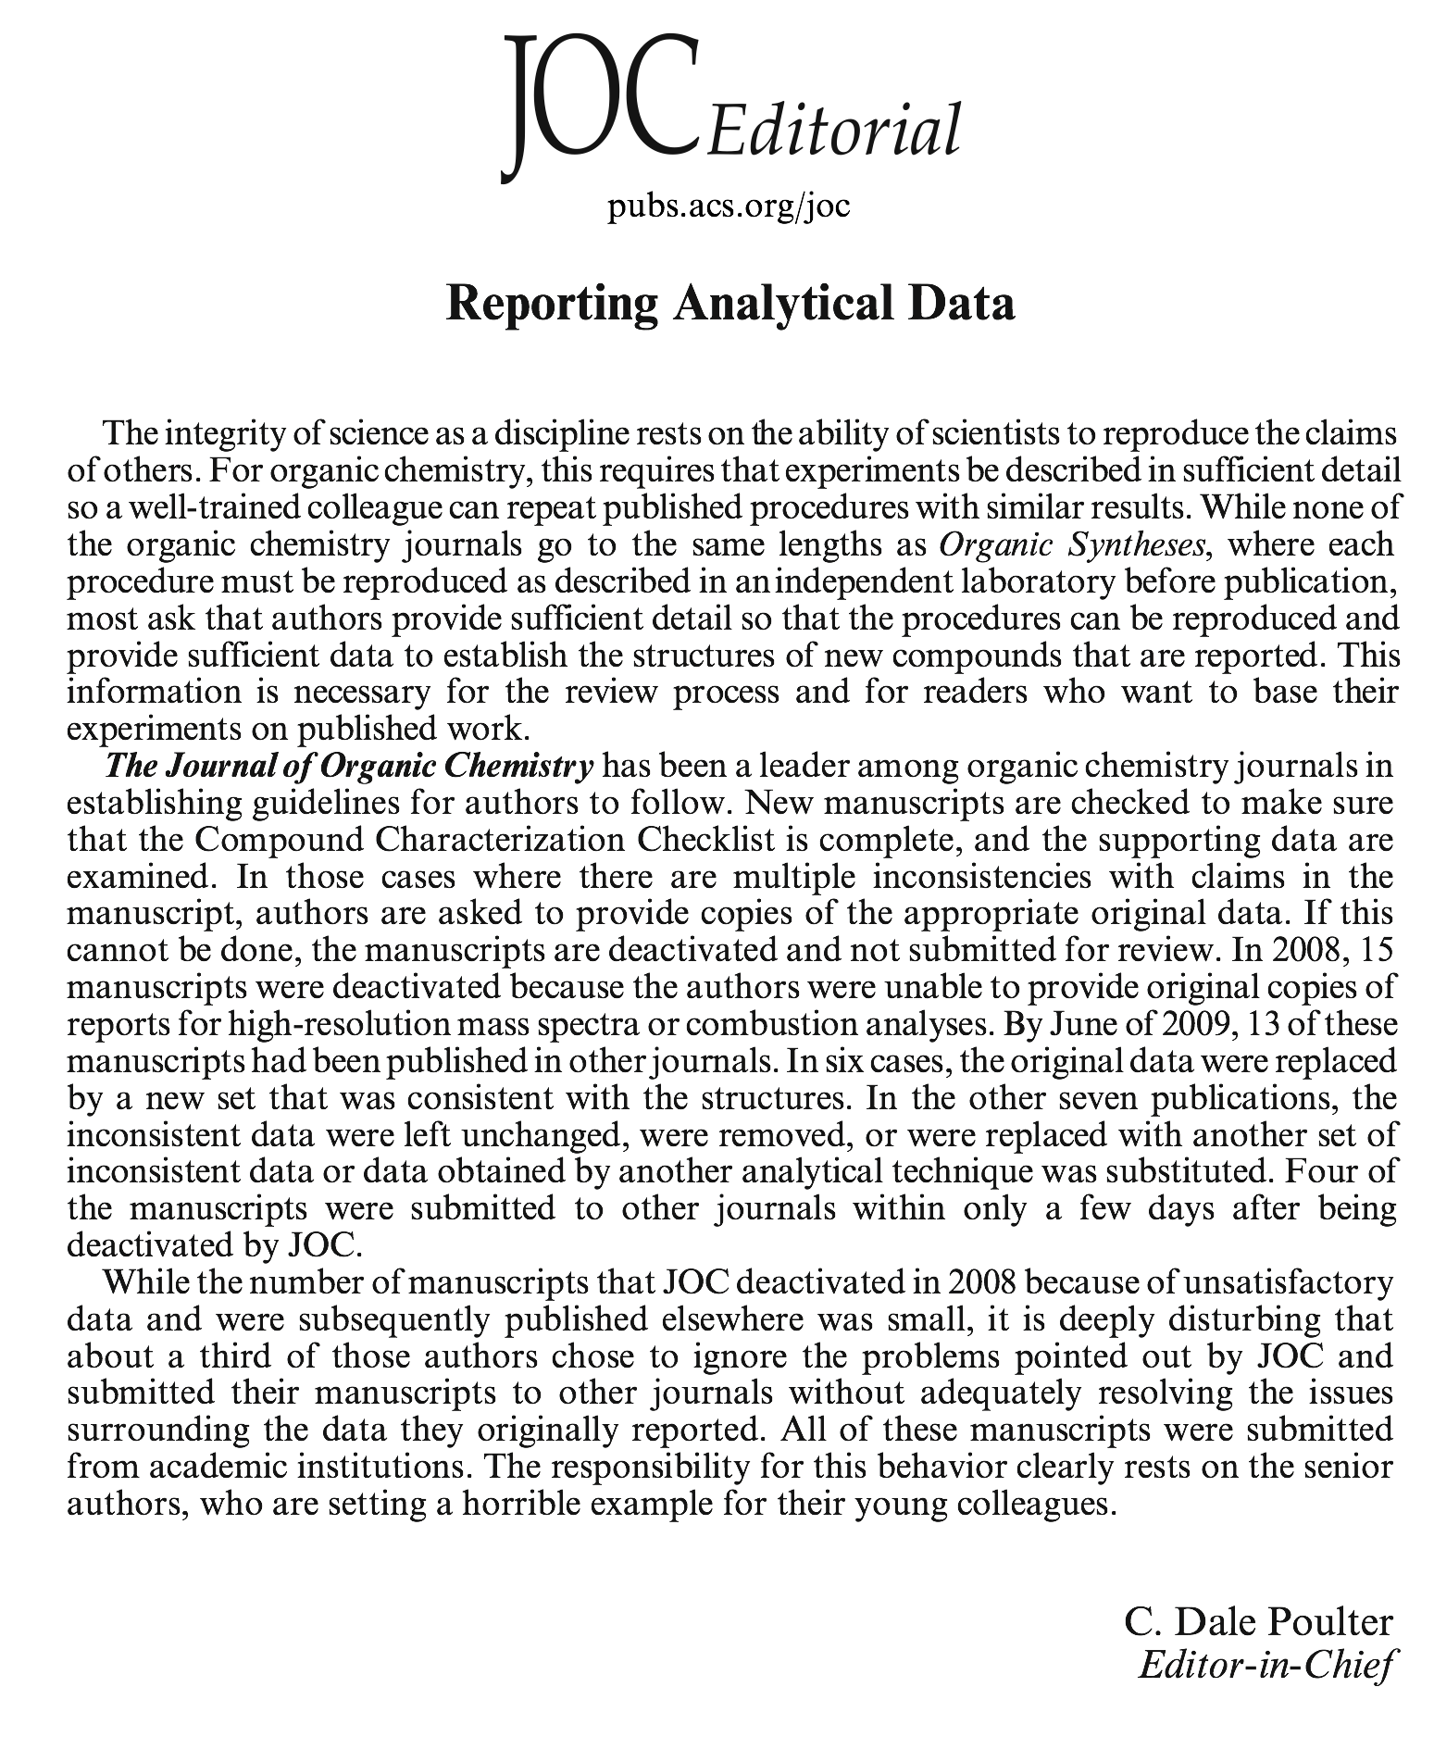
The integrity of science as a discipline rests on the ability of scientists to reproduce the claims of others.
While none of the organic chemistry journals go to the same lengths as Organic Syntheses, where each procedure must be reproduced as described in an independent laboratory before publication, ……..
sufficient detail so that the procedures can be reproduced and provide sufficient data to establish the structures …….
This information is necessary for the review process …… to base their experiments on published work.

Slide 22
Technology in Context

Slide 23
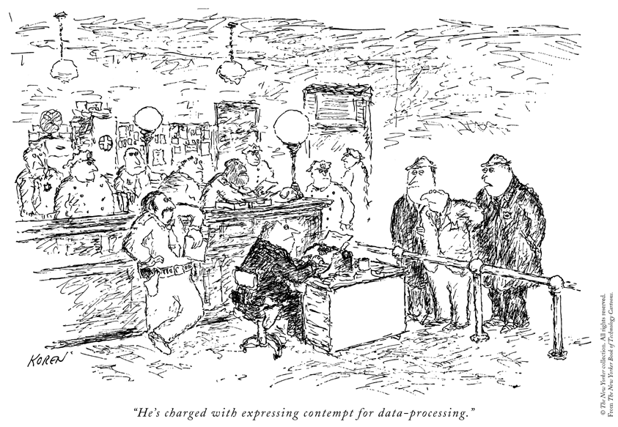
Core of Self describing data
Store of data that can be viewed and manipulated in different ways
User interfaces to suite user and occasion
He is charged with expressing contempt for meta-data

Slide 24
The Semantic Web
First described by Tim Berners-Lee in 2001
A stack of protocols and technologies
Enabling the machine-understanding of the meaning of information on the Web
http://upload.wikimedia.org/wikipedia/en/3/37/Semantic-web-stack.png

Slide 25
Resource Description Framework (RDF)
Based on the idea of making statements about resources
Facts are asserted as triples of the form: Subject, Predicate, Object
Caveat: all facts are assumed to be true
http://upload.wikimedia.org/wikipedia/commons/5/58/Rdf_graph_for_Eric_Miller.png

Slide 26
Resource Description Framework (RDF)
Subject | Predicate | Object
:mark_borkum | a | foaf:Person
:mark_borkum | foaf:name | “Mark Borkum”
:mark_borkum | foaf:mbox | mailto:m.i.borkum@soton.ac.uk
:jeremy_frey | a | foaf:Person
:jeremy_frey | foaf:name | “Jeremy Frey”
:jeremy_frey | foaf:mbox | mailto:j.g.frey@soton.ac.uk
“foaf” is the prefix for the Friend of a Friend (FOAF) namespace

Slide 27
RDF Schema (RDFS)
RDF is a syntax for describing data
RDFS extends RDF
RDFS is a mechanism for describing metadata that can be used to describe data, i.e., it describes vocabularies
RDFS defines classes like rdfs:Class and rdfs:Property
In addition, properties may be restricted to a specific domain and/or range

Slide 28
Web Ontology Language (OWL)
“An ontology is a specification of a conceptualisation” – Tom Gruber (1992)
OWL extends RDFS:
Classes
Relationships between classes
Properties of classes
Constraints on the relationships between classes (and properties of classes)

Slide 29
SPARQL Protocol and Query Language
SPARQL is an RDF query language
SPARQL queries can consist of:
Triple patterns
Conjunctions
Disjunctions
Optional patterns

Slide 30
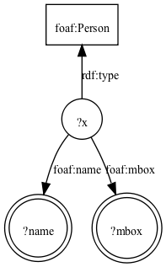
SPARQL Protocol and Query Language
PREFIX foaf: http://xmlns.com/foaf/0.1/
SELECT ?name ?mbox
WHERE {
?x a foaf:Person ;
foaf:name ?name ;
foaf:mbox ?mbox .
}
?name | ?mbox
“Mark Borkum” | mailto:m.i.borkum@soton.ac.uk
“Jeremy Frey” | mailto:j.g.frey@soton.ac.uk

Slide 31
Linked Data
Defined by Tim Berners-Lee in 2006
The four rules:
Use URIs to identify resources
Use HTTP to resolve the URIs
If someone looks up a URI, provide useful information, using the technologies in the Semantic Web stack
Link to other URIs

Slide 32
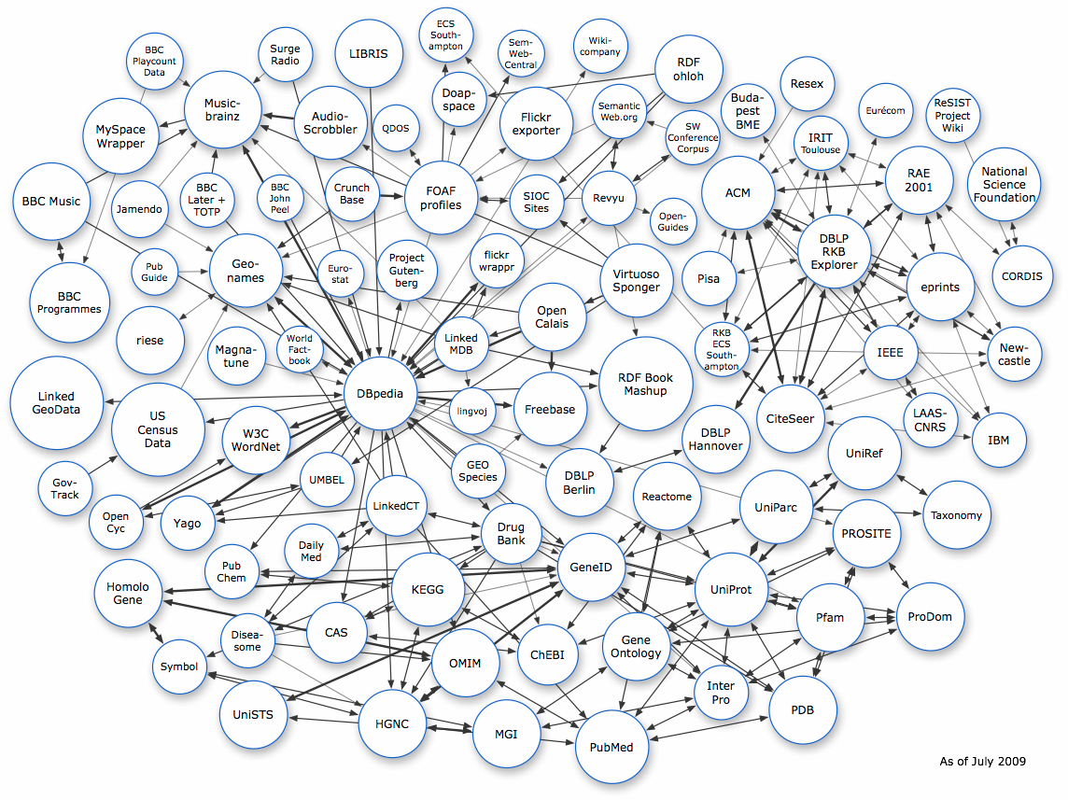
Chemistry

Slide 33
Data Model and Ontology

Slide 34
The oreChem Core Ontology
Describes three concepts:
The methodology (planned method) of a scientific experiment
The enactment of methodologies
The provenance of realised artefacts

Slide 35
Methodology (Planned Method)
The “plan” is modelled as a directed graph
Two node types:
Plan Stage description of an activity that will be enacted
Plan Object description of an artefact that will be realised

Slide 36
Relationships
Name | Domain | Range | Description
requires | Plan Stage | Plan Object | Specifies a pre-condition for the enactment of the ‘source’ (the ‘sink’ must be realised)
emits | Plan Stage | Plan Object | Specifies a post-condition for the enactment of the ‘source’ (the ‘sink’ must be realised)
follows | Plan Stage | Plan Stage | Specifies a pre-condition for the enactment of the ‘source’ (the ‘sink’ must be enacted)
derives | Plan Object | Plan Object | Denotes that the realisation of the ‘source’ will affect the realisation of the ‘sink’

Slide 37
Rules
Antecedent | Consequent
requires(?ps, ?po_a) ∧ emits(?ps, ?po_b) ∧ ?po_a ≠ ?po_b | derives(?po_a, ?po_b)
emits(?ps_a, ?po) ∧ requires(?ps_b, ?po) ∧ ?ps_a ≠ ?ps_b | follows(?ps_b, ?ps_a)

Slide 38
Enactment (of a Methodology)
Each “run” (of a plan) is modelled as a directed graph
Two node types:
Stage description of an activity that has been enacted
Object description of an artefact that has been realised

Slide 39
Relationships (2)
Name | Domain | Range | Description
used | Stage | Object | Records that the ‘source’ was enacted with the ‘sink’ as input
emitted | Stage | Object | Records that the ‘source’ was enacted with the ‘sink’ as output
followed | Stage | Stage | Records that the ‘source’ was enacted after the ‘sink’ (was enacted)
derivedFrom | Object | Object | Records that the ‘source’ was affected by the realisation of the ‘sink’

Slide 40
Rules (2)
Antecedent | Consequent
used(?s, ?o_a) ∧ emitted(?s, ?o_b) ∧ ?o_a ≠ ?o_b | derivedFrom(?o_b, ?o_a)
emitted(?s_a, ?o) ∧ used(?s_b, ?o) ∧ ?s_a ≠ ?s_b | followed(?s_b, ?s_a)

Slide 41
“In theory, there is no difference between theory and practice. But, in practice, there is.” Unknown (possibly Yogi Berra)

Slide 42
Provenance
Prospective
The plan describes a scientific experiment that will be enacted
Retrospective
The run describes a scientific experiment that has been enacted
Every ‘run thing’ is linked to exactly one ‘plan thing’

Slide 43
Relationships (3)
Name | Domain | Range | Description
hasPlan | Run | Plan | Records that the ‘source’ is a realisation of the ‘sink’
hasPlanStage | Stage | Plan Stage
hasPlanObject | Object | Plan Object

Slide 44
Applications

Slide 46
What is an “eCrystal”?
“each entry of this archive is all the fundamental and derived data resulting from a single crystal X-ray structure determination”
“the information supplied should enable any reader to check the reliability and validity directly”
http://ecrystals.chem.soton.ac.uk/29/

Slide 47
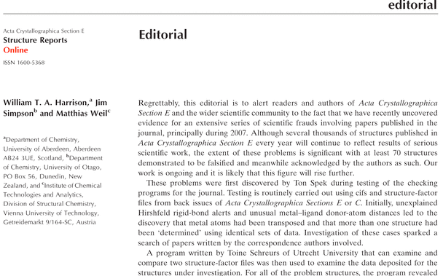
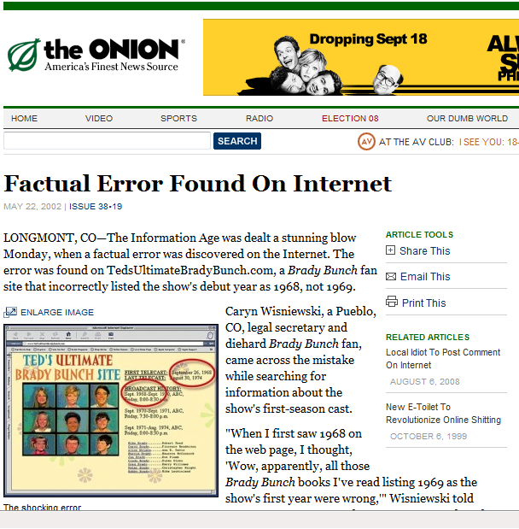
Problematic reproducibility, Lack of detail, Fraud?
Crystal Gate
Fraudulent manipulation of raw data to create apparently new structures
Detected by comparisons of detailed and raw data
A risk of exposing raw data – makes it possible for more believable fraud

Slide 48
X-ray Crystallography in a Nutshell
Take a sample of a crystalline solid (or “crystal”)
Bombard the sample with beams of X-rays
Record the angle and intensity of all diffracted X-ray beams
Deduce 3-dimensional model of electron density within the crystal
Calculate atom positions, chemical bonds, etc…
http://upload.wikimedia.org/wikipedia/commons/4/4a/2D_x-ray_diffractometer_at_University_of_Helsinki_in_English.JPG

Slide 49
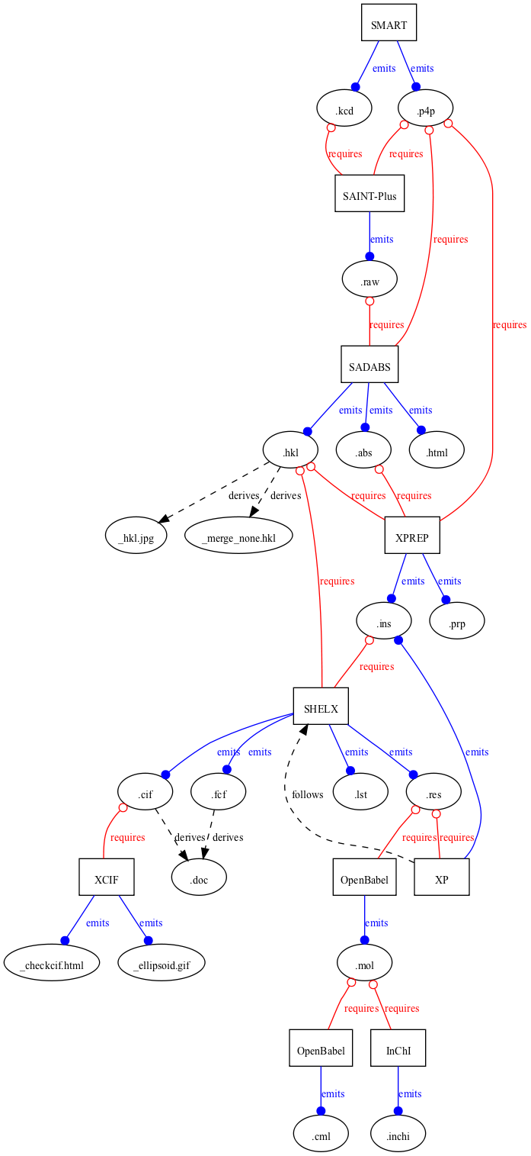
An oreChem Plan for eCrystals
http://ecrystals.chem.soton.ac.uk/plan.rdf

Slide 50
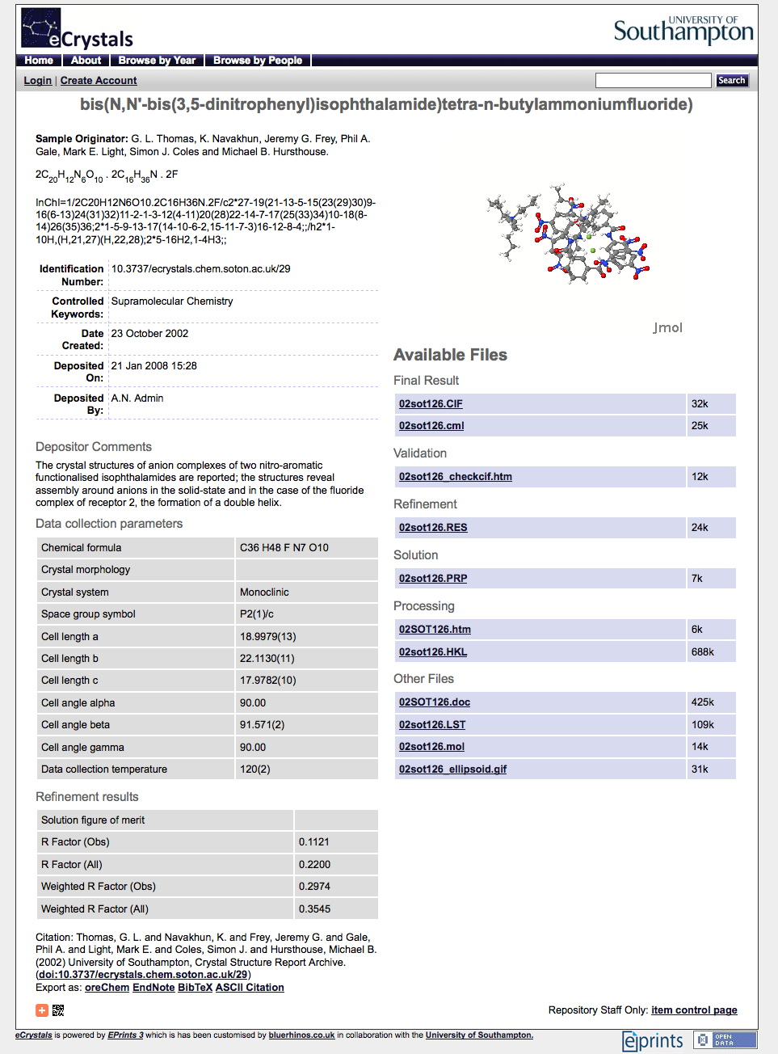
eCrystal #29 + oreChem
http://ecrystals.chem.soton.ac.uk/29/
used
emitted

Slide 51
eCrystal #29 + oreChem (2)
Stages
Objects
derivedFrom
followed

Slide 52
Querying eCrystals using oreChem
Given the raw X-ray diffraction data for a single crystal (a .hkl file), and the reported crystal structure (a .cif file); find all intermediate data files.
Raw
Derived
Reported

Slide 53
Querying eCrystals using oreChem (2)

Slide 54
Querying eCrystals using oreChem (3)
derivedFrom

Slide 55
Querying eCrystals using oreChem (4)
Binding | ?run | ?raw | ?derived | ?reported
1 | eCrystal #29 | 02sot126.hkl | 02sot126.prp | 02sot126.cif
2 | eCrystal #29 | 02sot126.hkl | 02sot126.lst | 02sot126.cif
3 | eCrystal #29 | 02sot126.hkl | 02sot126.res | 02sot126.cif

Slide 56
The oreChem Workflow

Slide 57
http://ecrystals.chem.soton.ac.uk/ cgi/latest_tool?output=Atom
Notes:
http://ecrystals.chem.soton.ac.uk/cgi/latest_tool?output=Atom

Slide 58
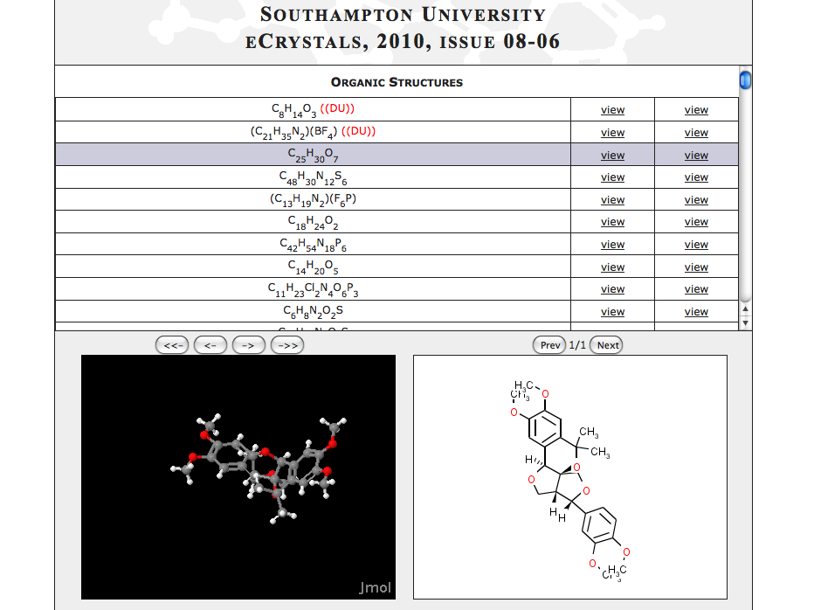
http://wwmm.ch.cam.ac.uk/crystaleye/summary/soton/ecrystals/2010/08-06/
Notes:
http://wwmm.ch.cam.ac.uk/crystaleye/summary/soton/ecrystals/2010/08-06/

Slide 59
Summary

Slide 60
Summary
The oreChem project demonstrates the power of a simple ontology.
Compatible with domain specific additional ontologies.
Formalizes the concept of a Plan and maximises the use of this prior information in interpreting and providing provenance for experimental (and computational) data.
Enables automatic discovery of the provenance.

Slide 61
Acknowledgements
Mark Borkum & Simon Coles (Southampton)
Carl Lagoze (Cornell)
The oreChem Project (Southampton, Cambridge, Indiana and Penn State)
eCrystals - Andrew Milsted (Southampton), Liz Lyon (UKOLN)
Hugo Mills, Dave De Roure (Smart Tea)

Slide 62
Funding
Microsoft External Research (MSR)
EPSRC (CombeChem & CombeChem Platform Grant & studentships)
JISC (eBank/eCrystals)
Worldwide University Network (WUN)

